Slide 1
Memento Design Pattern
Memento is a behavioral design pattern that lets you save and restore the previous state of an object without revealing the details of its implementation.
The mechanism in which you store the object’s state depends on the required duration of persistence, which may vary.
Memento pattern without violating encapsulation, capture and externalize an object's internal state so that the object can be restored to this state later.
@ShankaragoudaG

Slide 2
Memento Design Pattern
Hydration is a technique in web development where the client-side takes static content which was stored in any programming language such as JSON, JavaScript, HTML, etc., and converts it into code that browsers are able to run during runtime.
At that stage, JavaScript is run and is able to do things like attach event listeners when the DOM begins running on the page.
The memento pattern is similar.

Slide 3
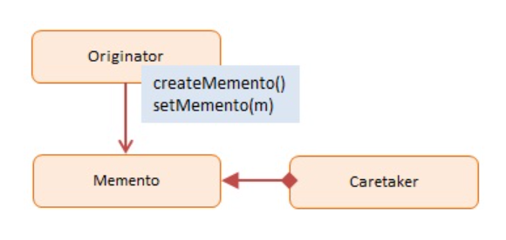
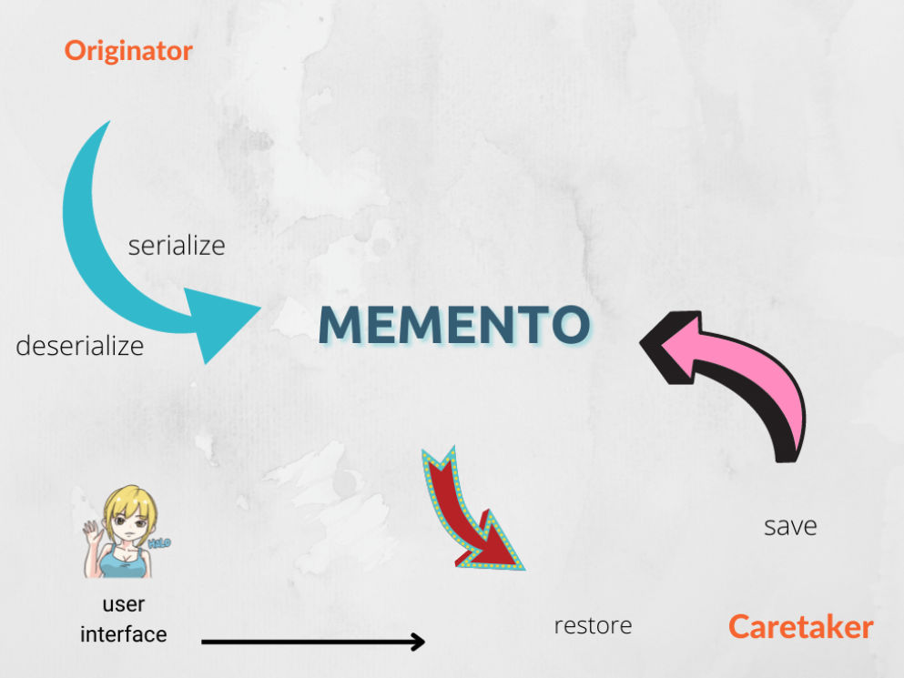
Diagram
In JavaScript Mementos are easily implemented by serializing and de-serializing objects with JSON.

Slide 4
Participants
Originator:
implements interface to create and restore mementos of itself
the object which state is temporary being saved and restored
Memento:
internal state of the Originator object in some storage format
CareTaker:
responsible for storing mementos
just a repository; does not make changes to mementos

Slide 5
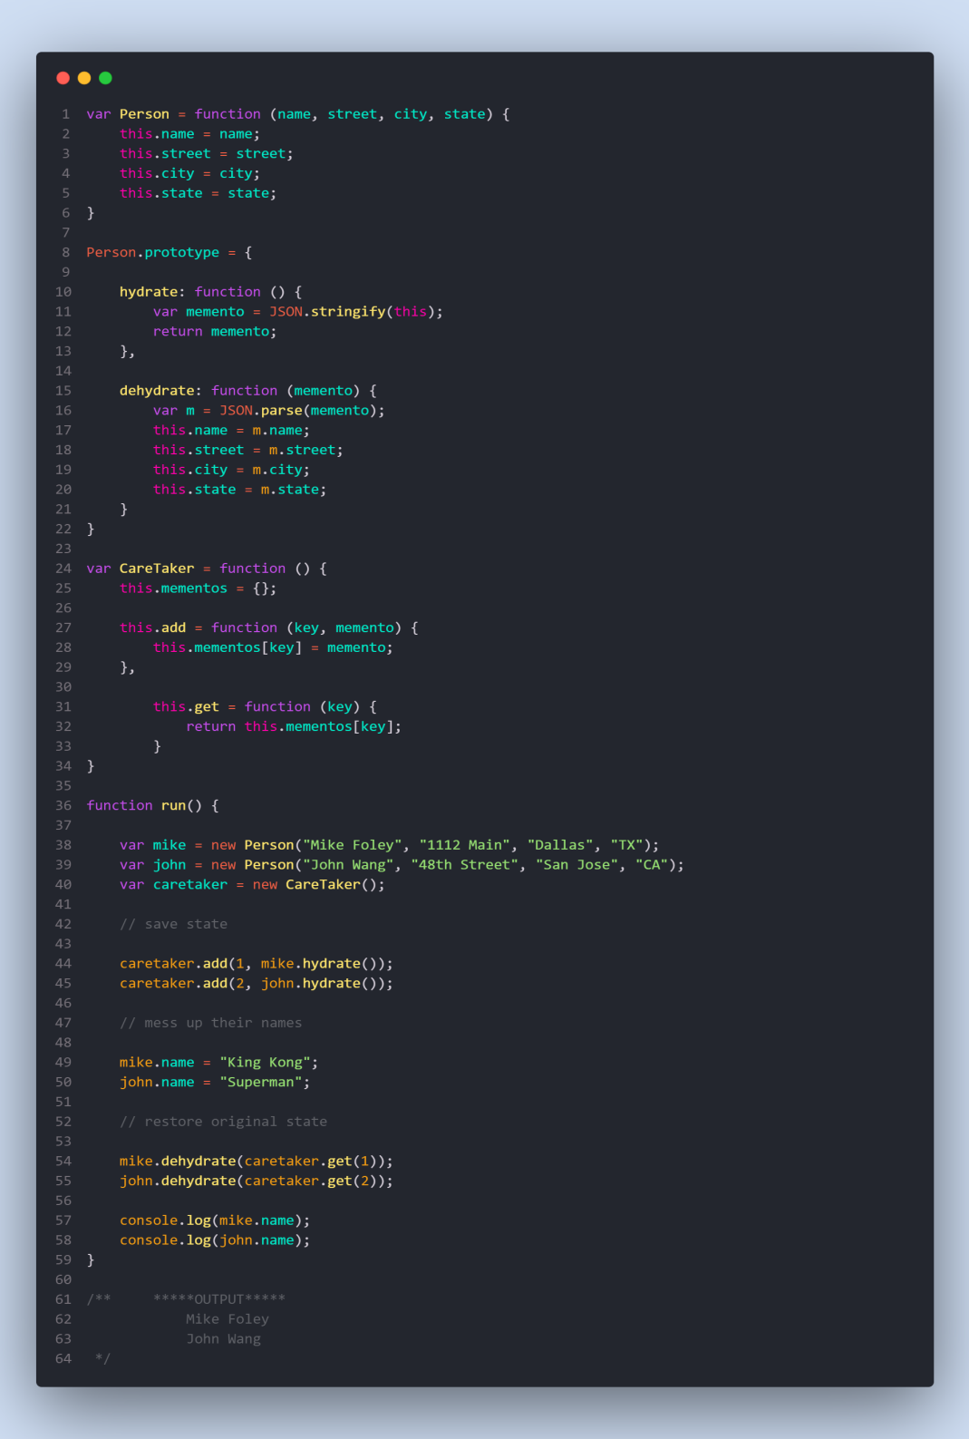
Example

Slide 6
Useful Resources
https://betterprogramming.pub/the-power-of-memento-design-pattern-in-javascript-309f8bb4d9f2
https://refactoring.guru/design-patterns/memento
https://www.dofactory.com/javascript/design-patterns/memento
https://designpatternsgame.com/patterns/memento

